Slide 1

DXC – REALTIME PROJECT
AZ-900, DP-203
June 10, 2022
DXC TECHNOLOGY PVT. LTD.

Slide 2
Name: Ashok Kumar
Batch: DXC-262-Analytics-B12-Azure
Roll No.: DXC262AB12033
TRAINER NAME: MR. AJAY KUMAR
Project 1: Smart vehicles
Project 2: AP Morgan Data Platform

Slide 3
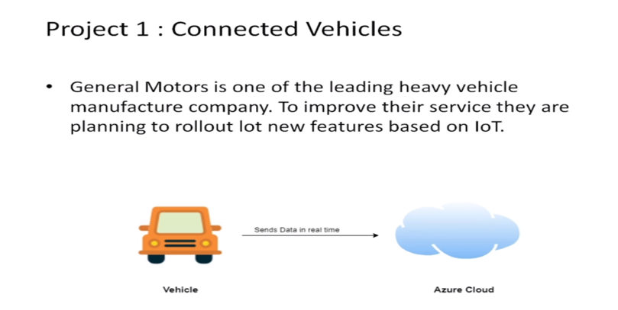
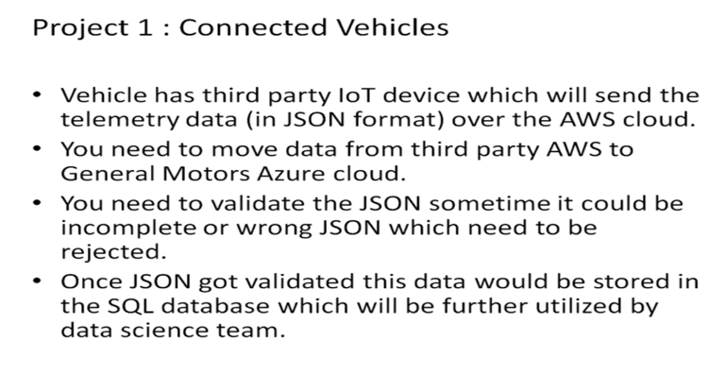
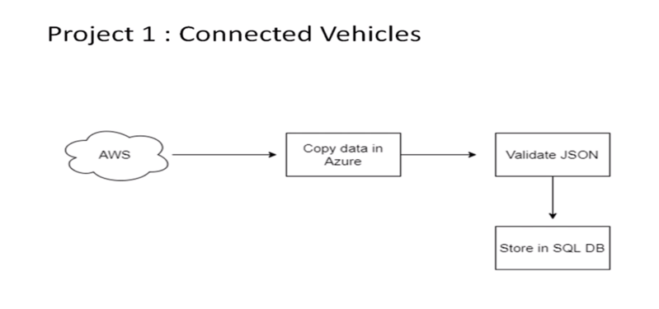
Project – 1: Smart Vehicles

Slide 4
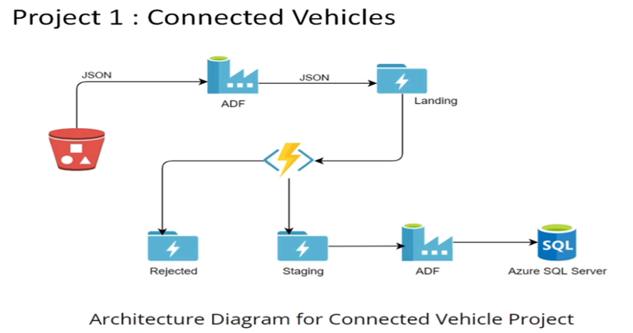

Slide 5
Steps to implement project-1
Practical Lab: Create Azure Data Factory Account For Data pipelines
Practical Lab: Create ADF Pipeline End to end pipeline with triggers enabled
Practical Lab: Create Azure blob trigger logic
Practical Lab: Create Azure SQL Server and Database
Practical Lab: Add another pipelines for moving data from Staging to SQL DB

Slide 6
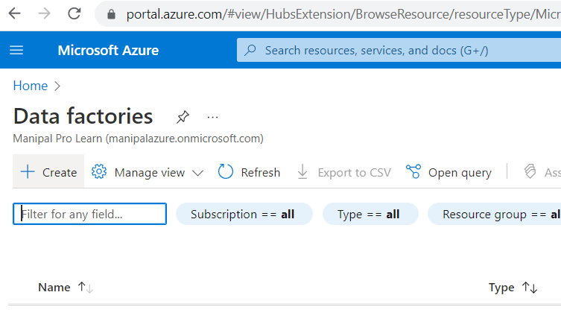
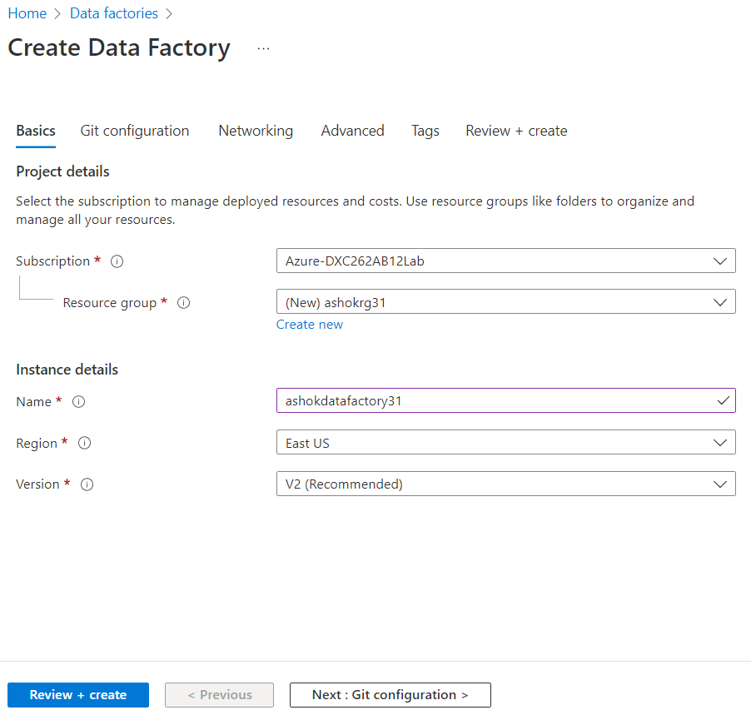
Create Azure Data Factory
Go to https://portal.azure.com/#home and search Azure Data Factory.
Click on create and fill the details to create data factory.
Then click on review+create and wait until deployment is complete.

Slide 7
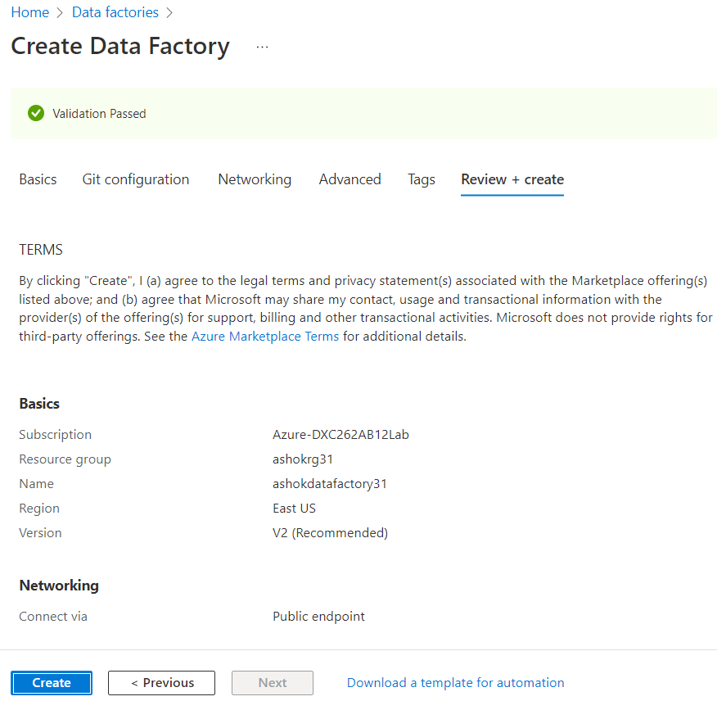
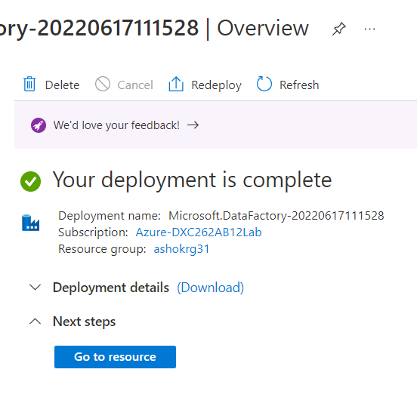

Slide 8
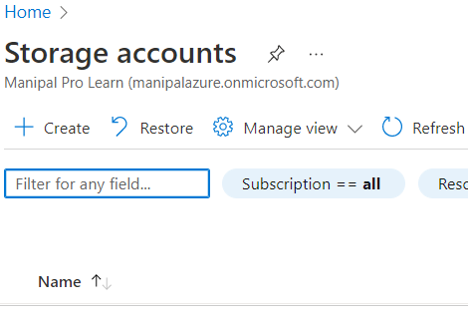
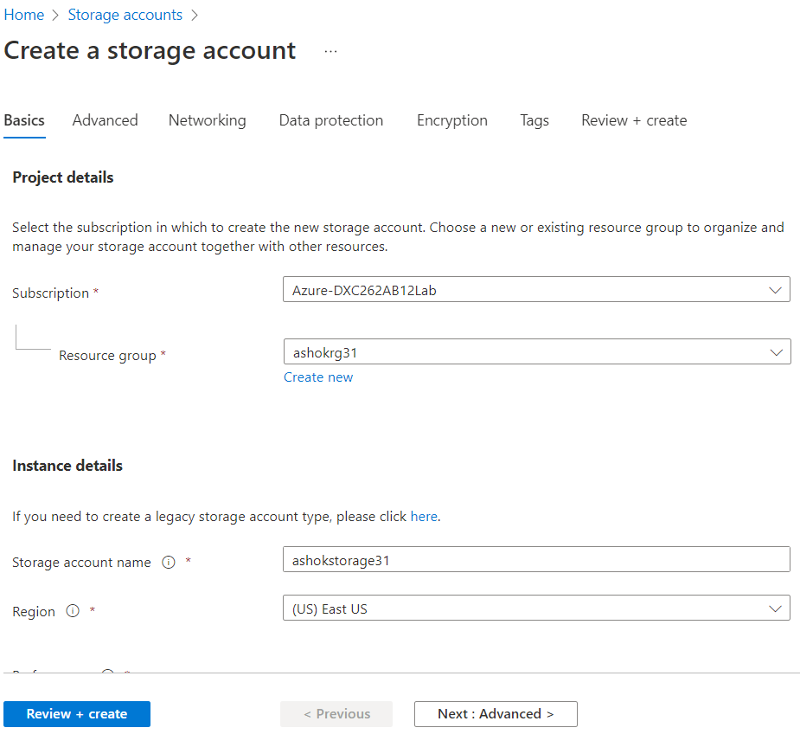
Create Storage Account
→ To create storage account search storage accounts on https://portal.azure.com/#home and click on create and fill required details for storage account the click on review+create and wait for deployment is complete.

Slide 9
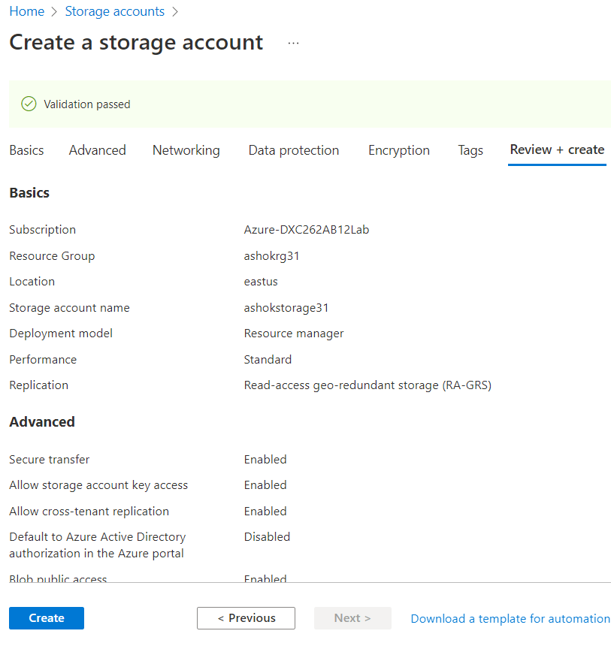
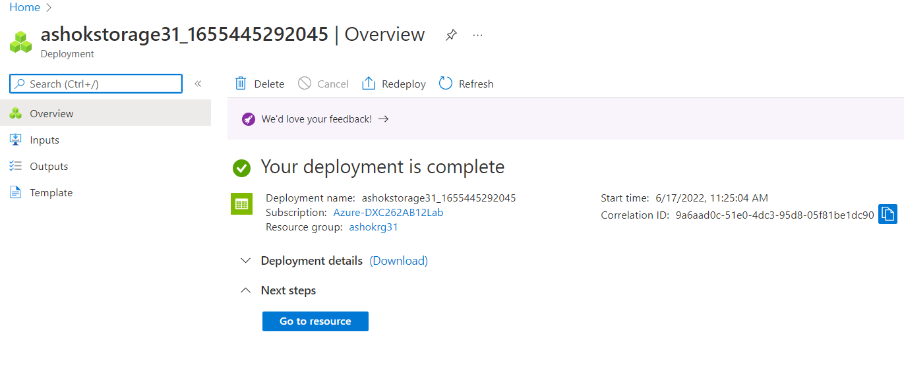

Slide 10
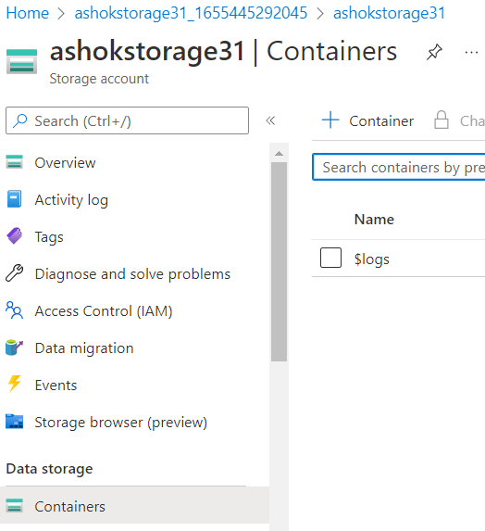
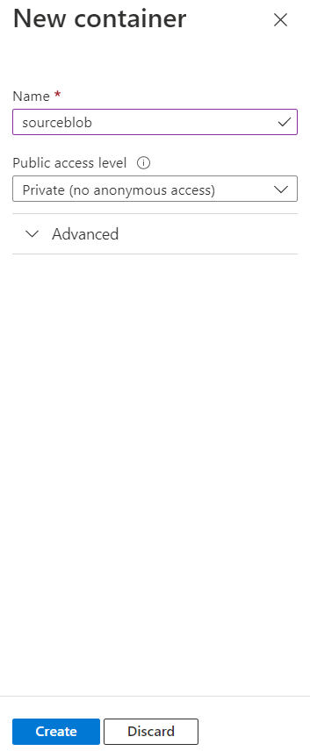
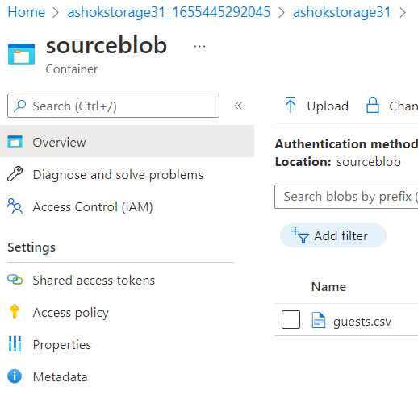
Creating container in storage account
When the deployment is complete click on Go to resource.
Now we will create container to store source data
Click on Containers then +Container to create container.

Slide 11
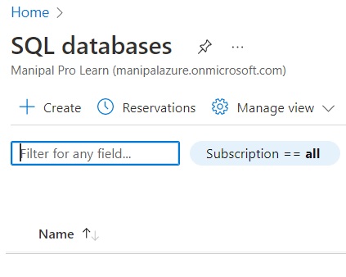
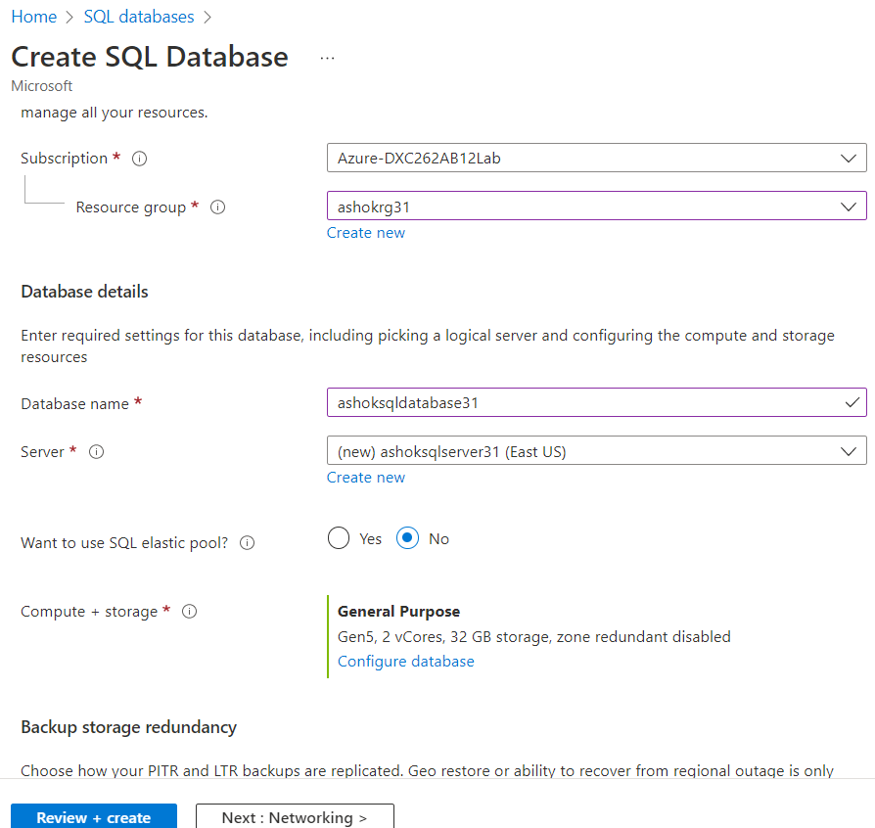
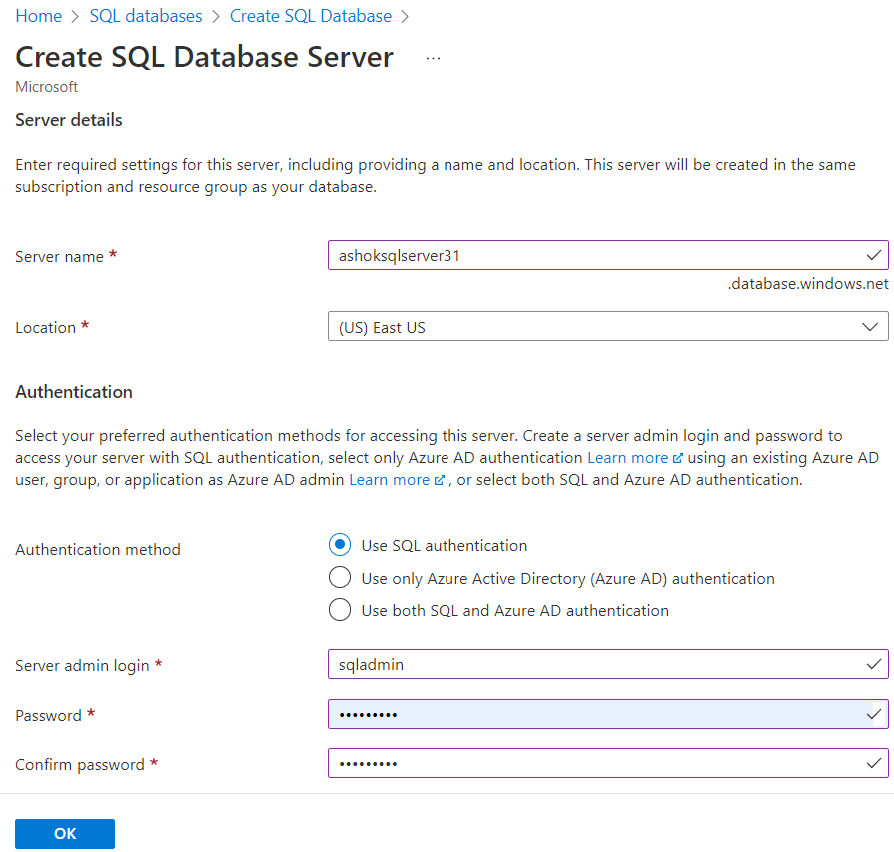
Creating SQL database
Create SQL database to store data at destination.
To create SQL database search SQL database on https://portal.azure.com/#home and click on create and fill required details for SQL database the click on review+create and wait for deployment is complete.

Slide 12
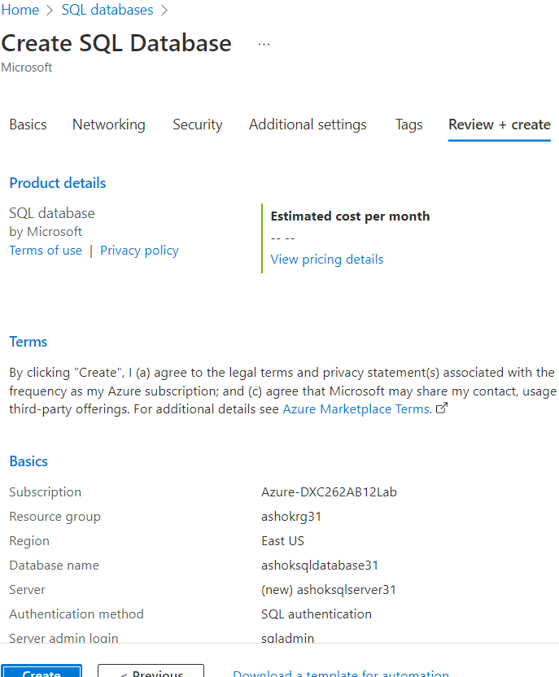
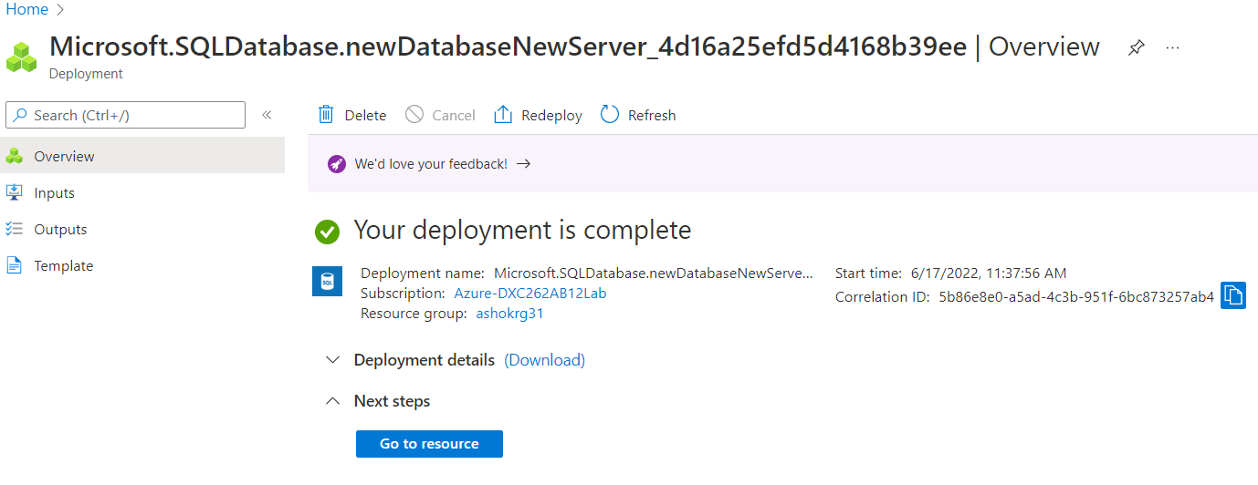

Slide 13
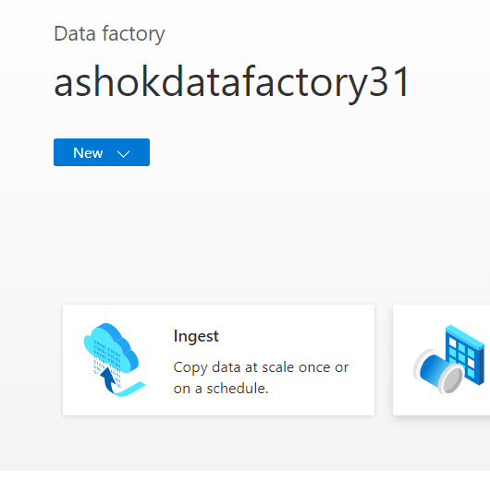
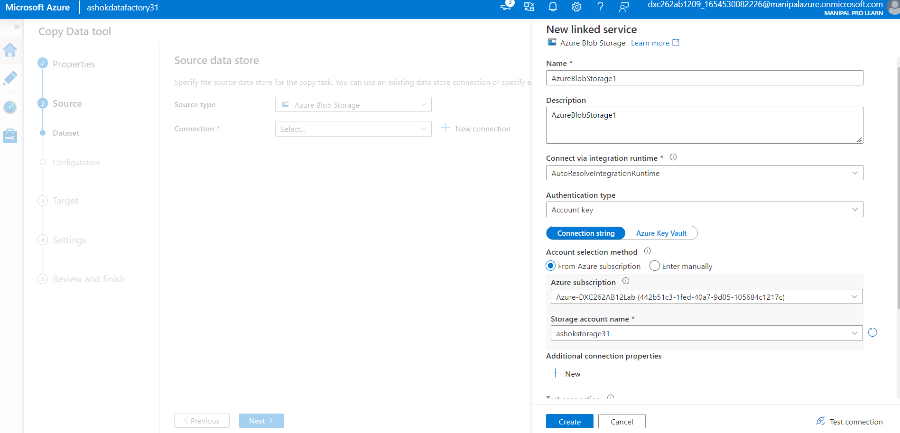
Create pipeline
→ Go to Azure Data Factory lab to create pipeline to send data from blob storage to SQL database.
→ Open Azure Data Factory Studeio then Click on Ingest and enter the details in new linked services

Slide 14
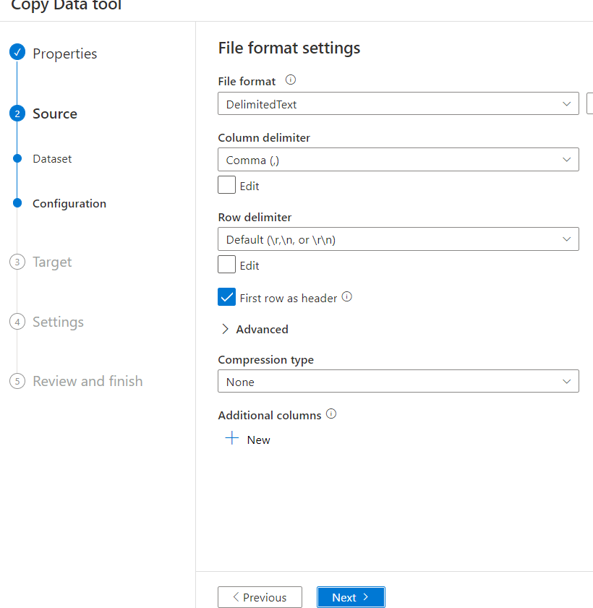
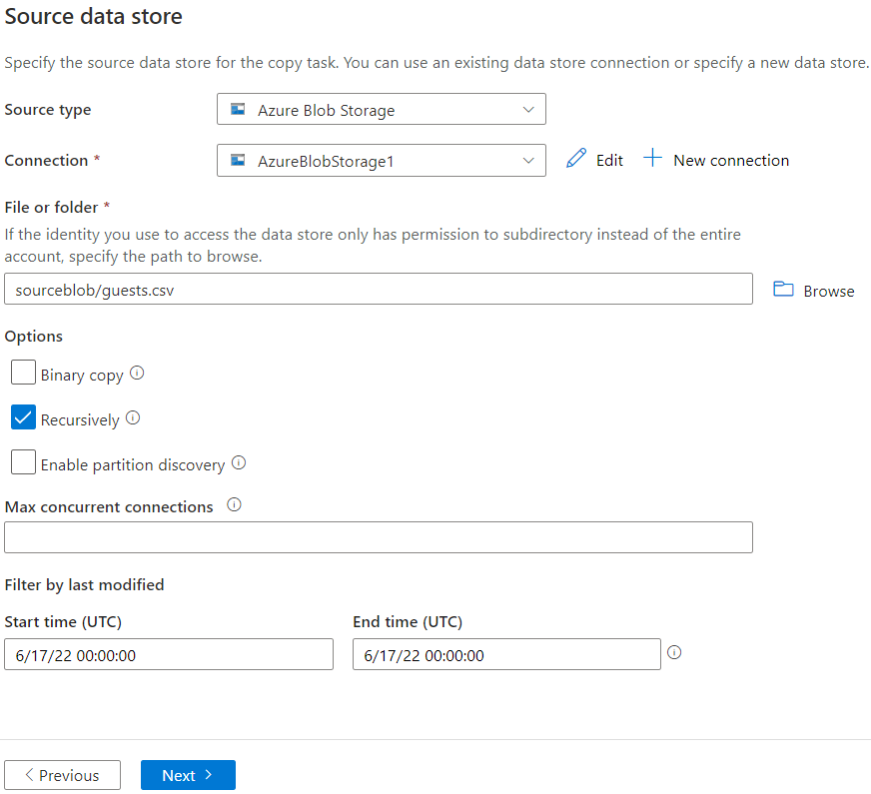
Select the source type as blob storage and connection name and root folder then click on next.
Choose output format of data

Slide 15
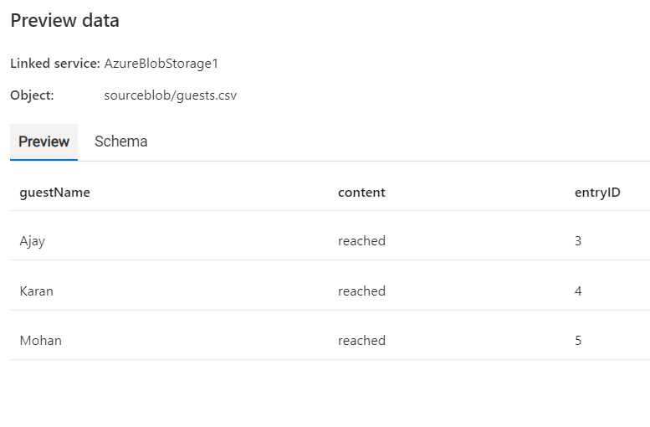
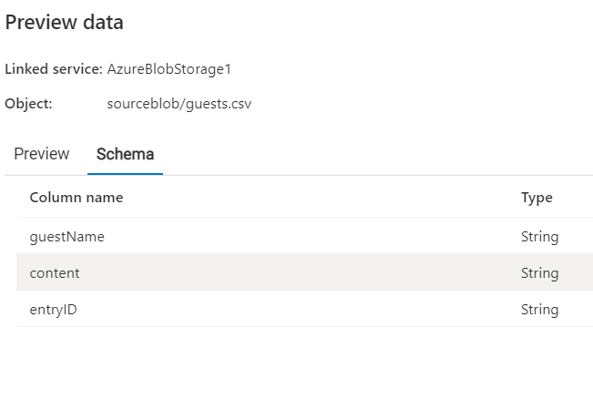

Slide 16
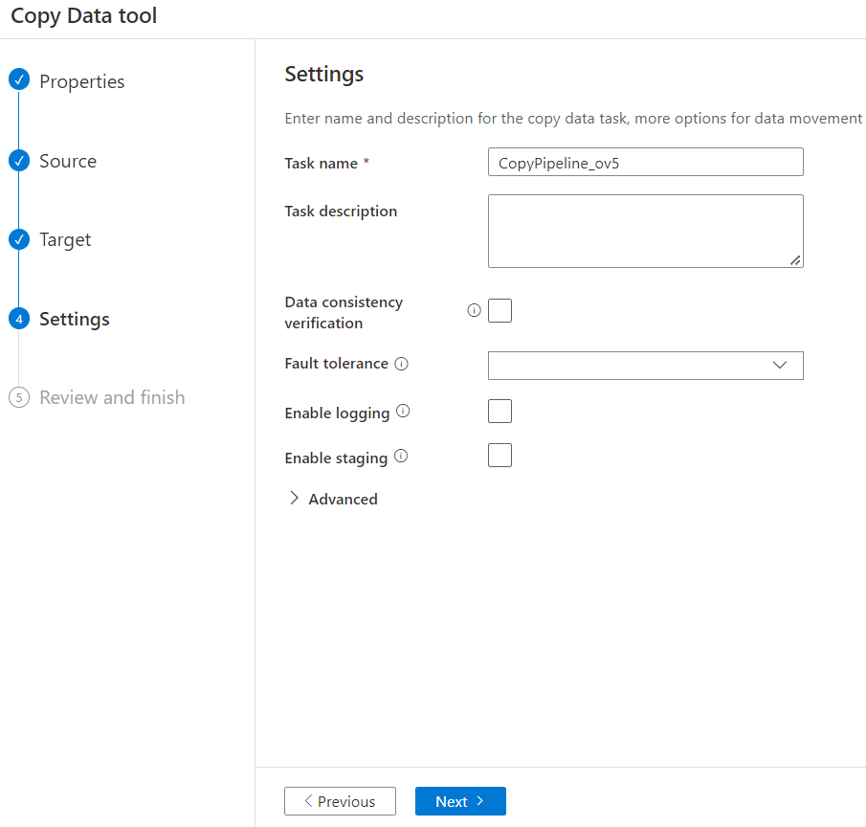
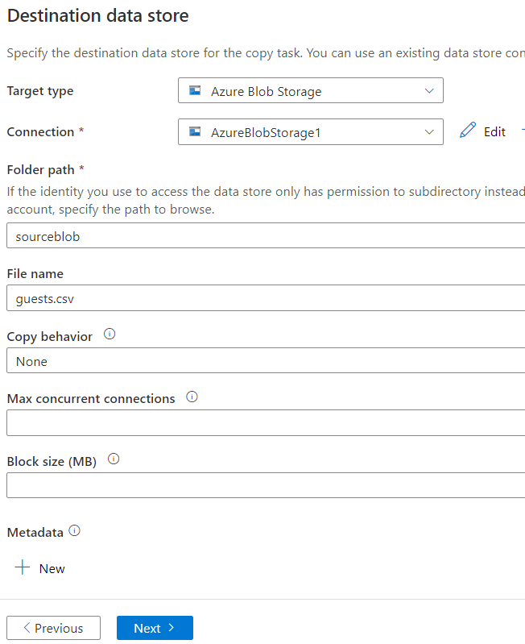
Destination Data Store
→ Choose the target type and Connection

Slide 17
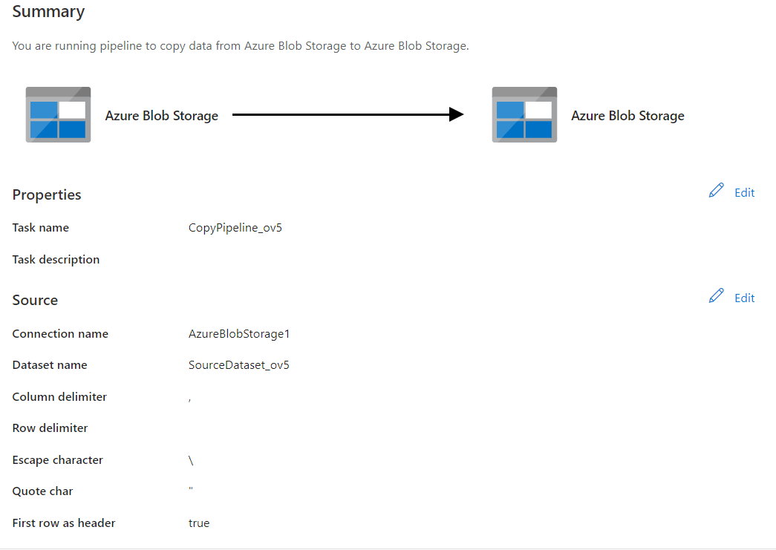
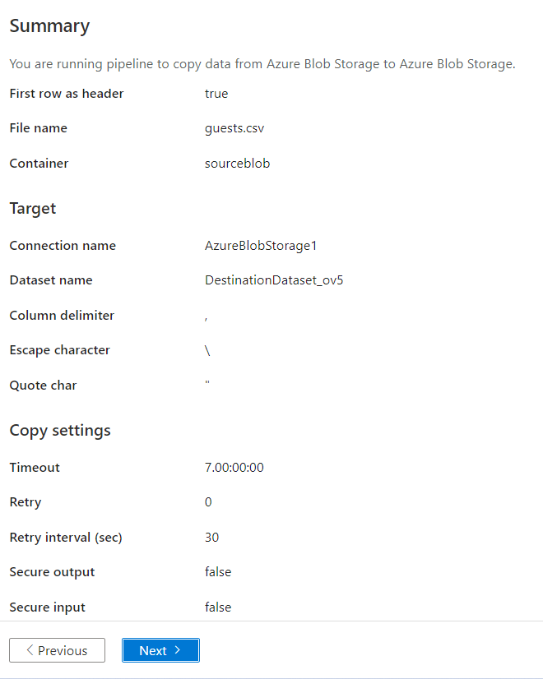

Slide 18
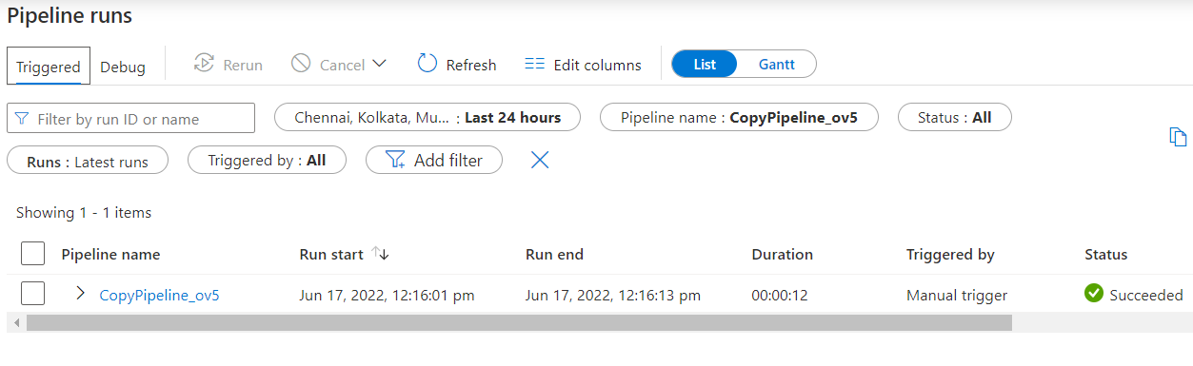
Triggering Pipeline
Trigger the pipeline manually and go to Monitor to see successful running of our pipeline and go to SQL database to check data.

Slide 19
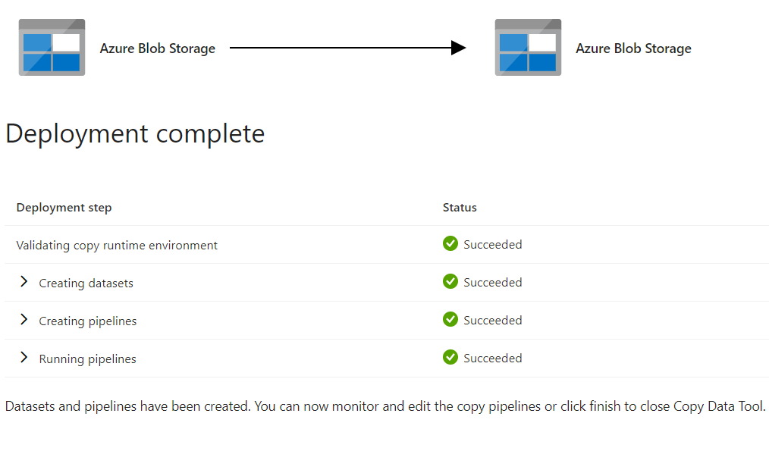
Results and conclusion
Results: created pipeline in azure data factory that will send blob data into SQL database.
Conclusion: data is successfully sent to SQL Database.

Slide 20
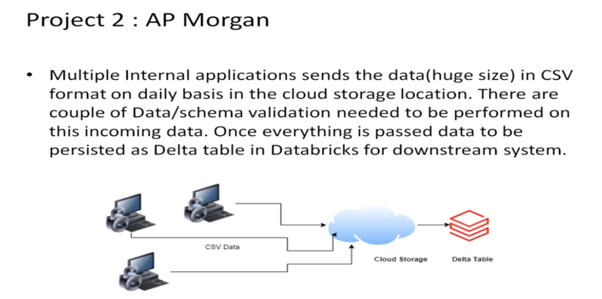
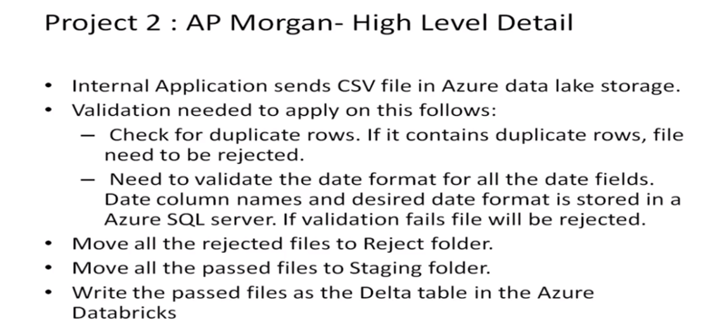
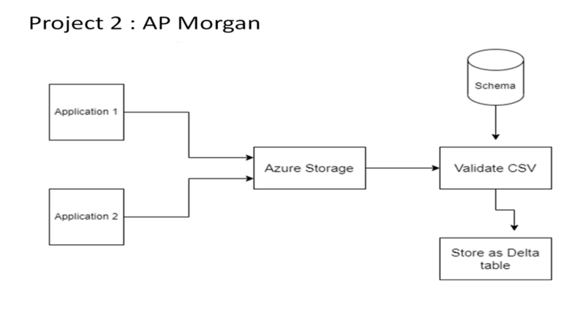
Project – 2: AP Morgan Data Platform

Slide 21
Steps to implement project-2
Practical Lab: Create a Databricks
Practical Lab: Create Cluster in Azure Databricks
Practical Lab: Add notebook in Databricks and Implement the Business Logic
Practical Lab: Azure Data Factory For AP Morgan
Practical Lab: Create Azure Databricks Linked Service in ADF

Slide 22
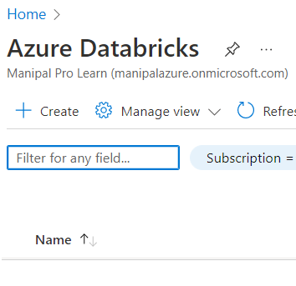
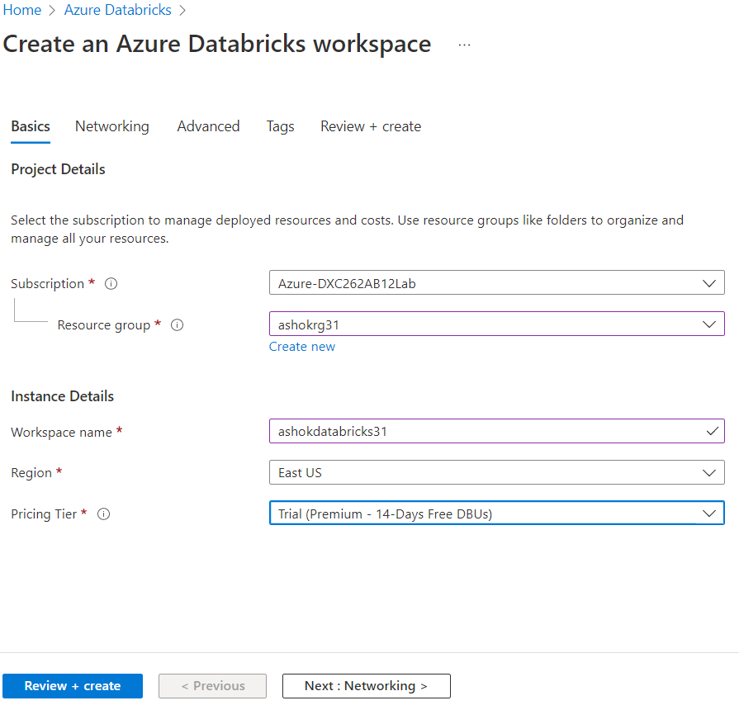
Create azure databricks
Go to https://portal.azure.com/#home and search Azure Data Bricks.
Click on create and fill the details to create data bricks.

Slide 23
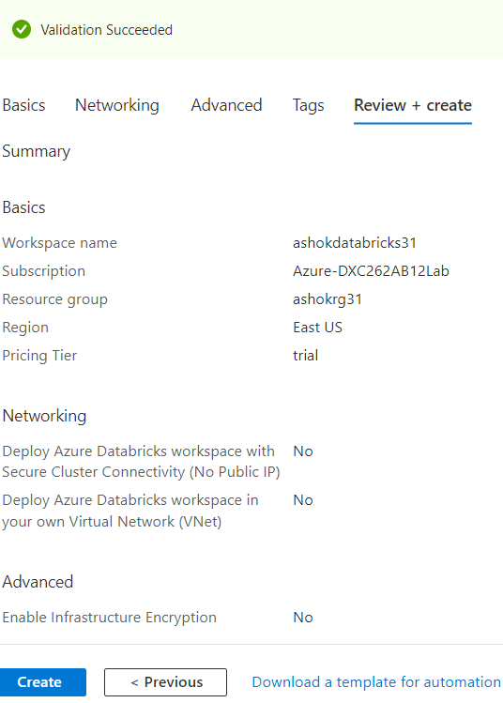
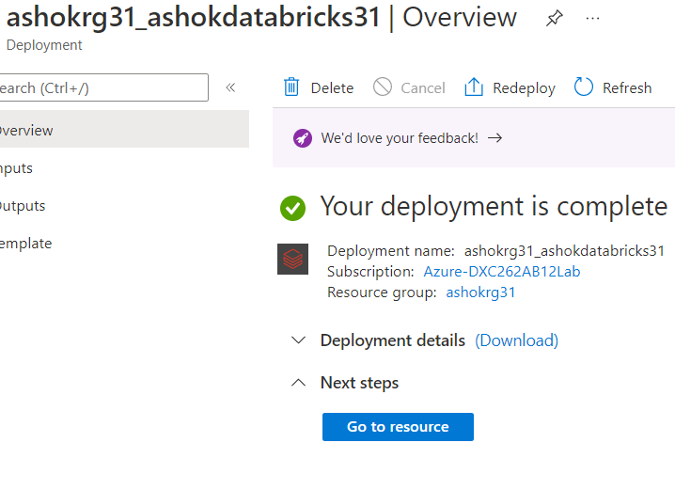
→ click on review+create and wait until deployment is complete

Slide 24
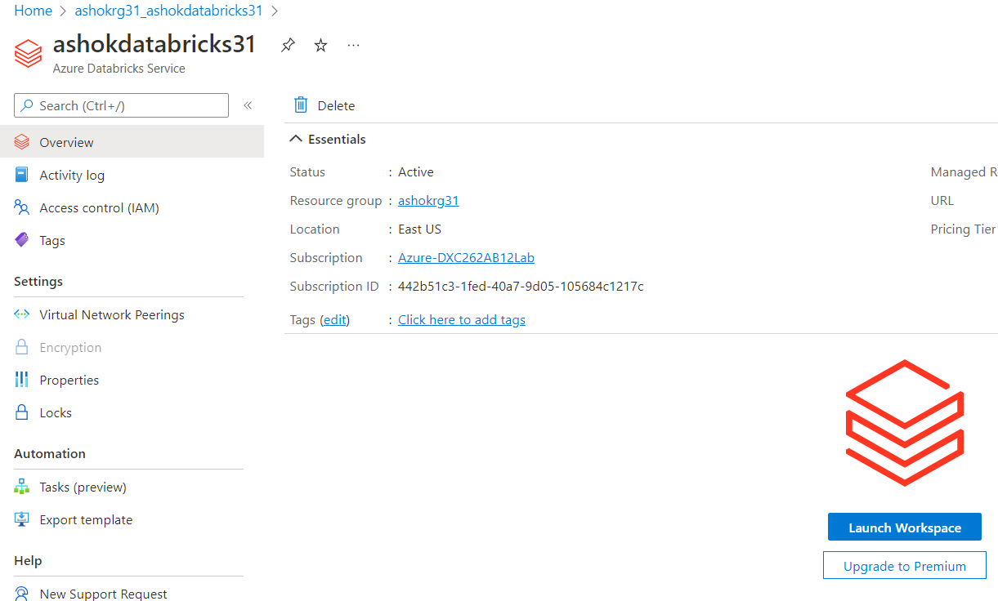
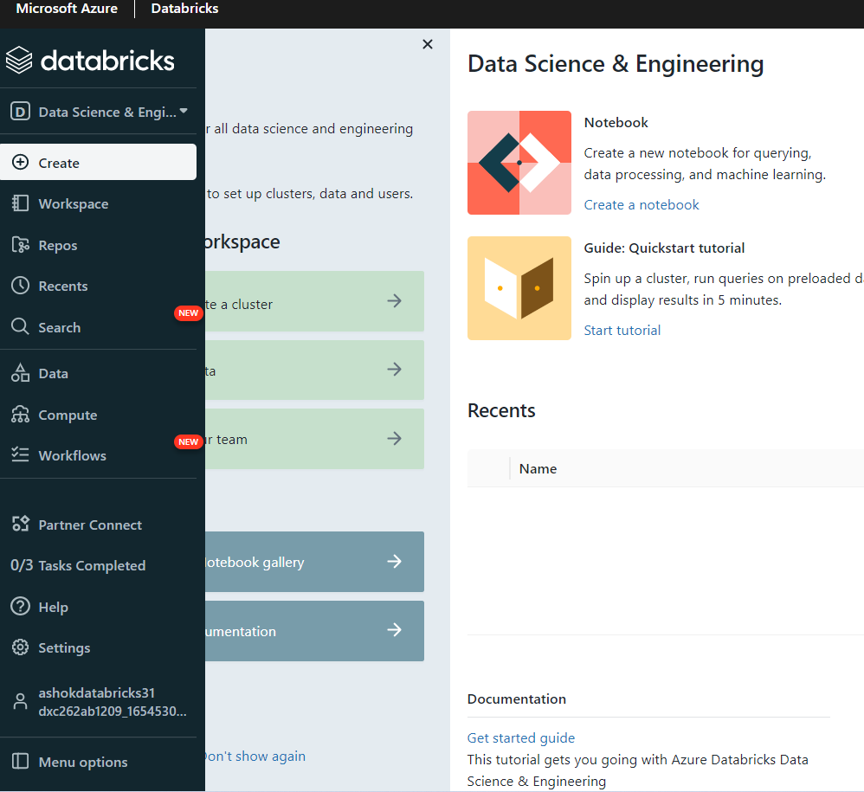
→ Click on Go to resources then launch workspace to go to data bricks account.

Slide 25
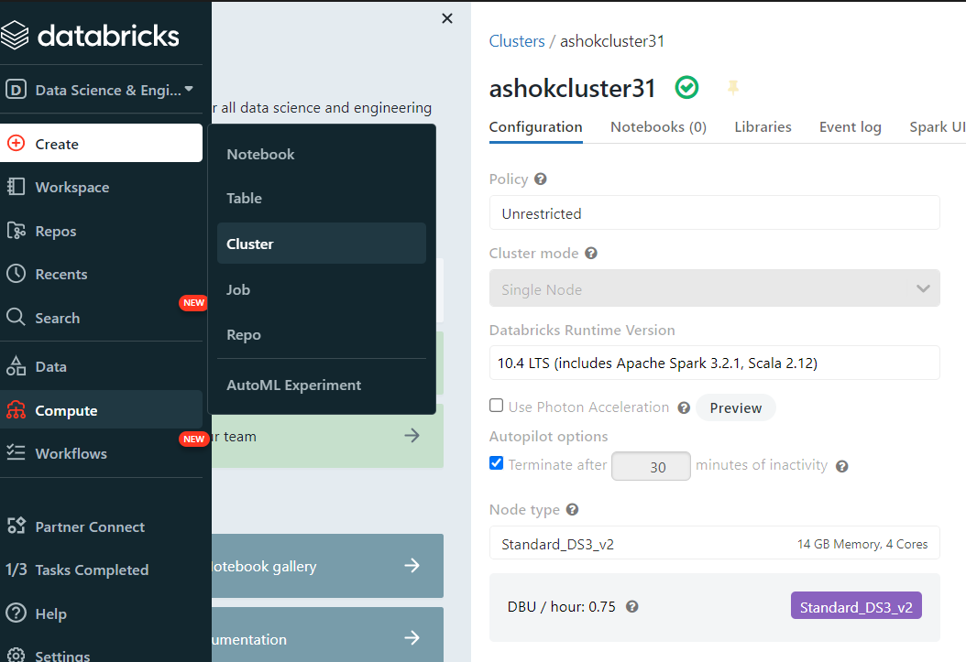
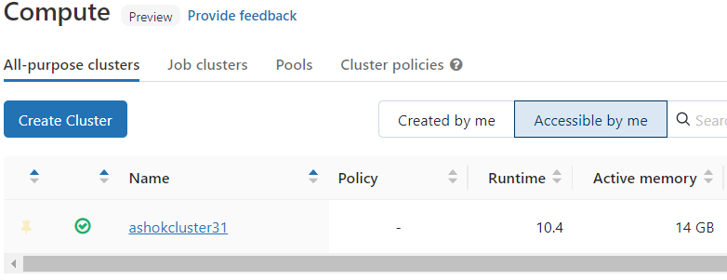
Create Cluster in Azure Databricks
To create new cluster in azure databricks go to create in databricks workspace and click on cluster and fill the cluster name and other details about cluster and click on new cluster and cluster will be created.

Slide 26
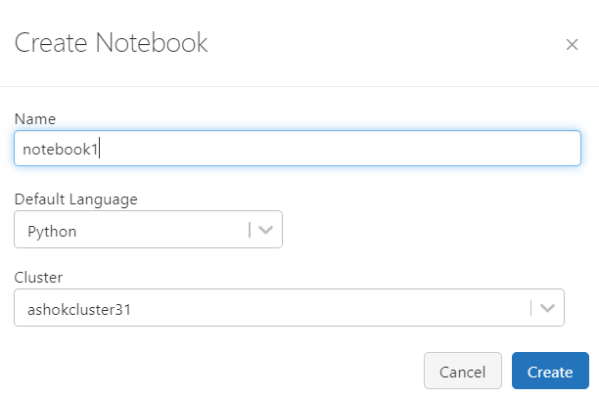
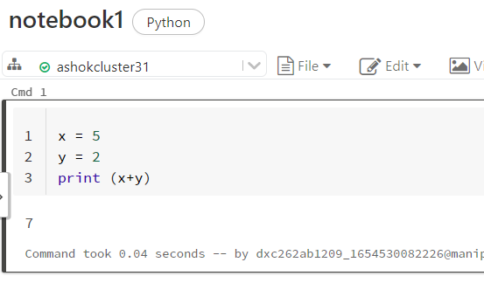
Create Notebook
To create notebook in azure databricks go to create in databricks workspace and click on notebook and fill the notebook name and click on create and notebook will be created.

Slide 27
Create Azure Data Factory
Go to https://portal.azure.com/#home and search Azure Data Factory.
Click on create and fill the details to create data factory.
Then click on review+create and wait until deployment is complete.

Slide 29
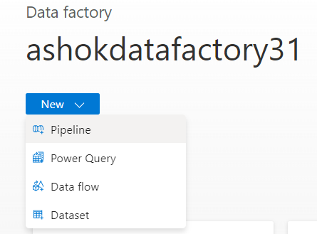
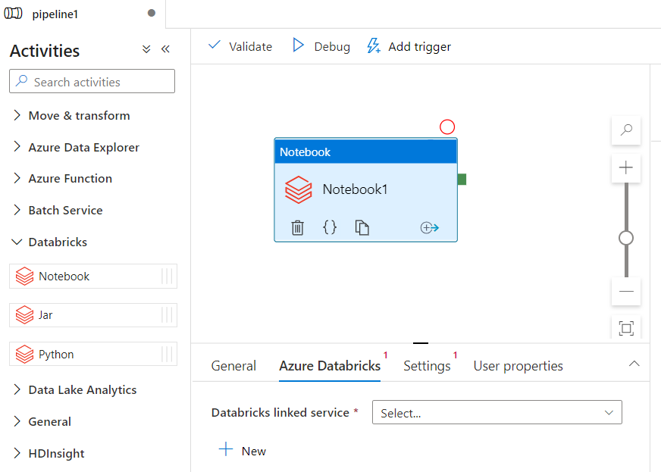
Create new pipeline
Create pipeline to connect data bricks notebook with data factory.
Create new pipeline and drag & drop notebook from Azure Databricks dropdown into the pipeline workspace

Slide 30
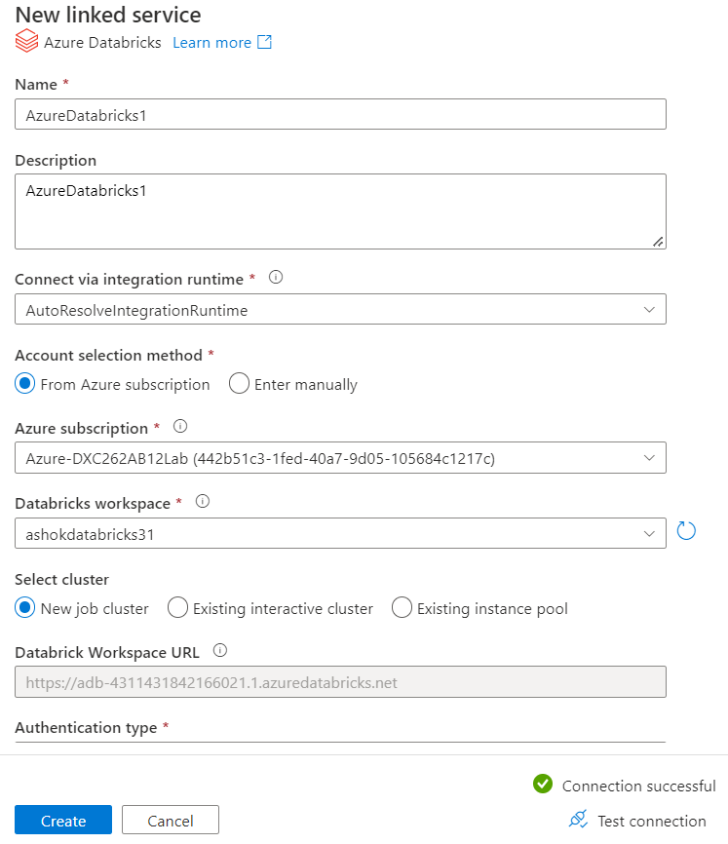
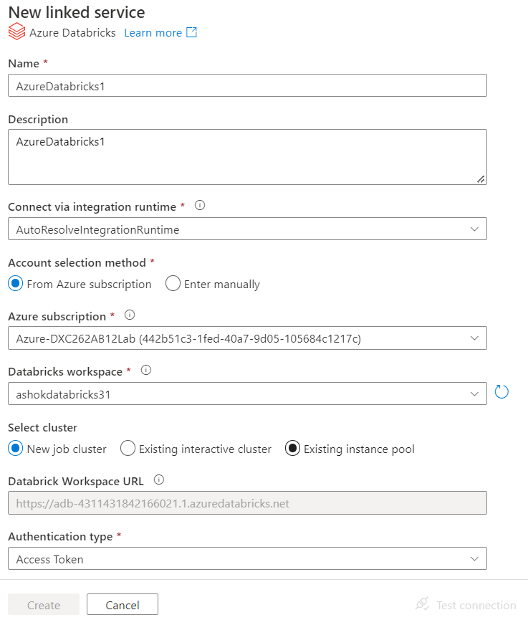
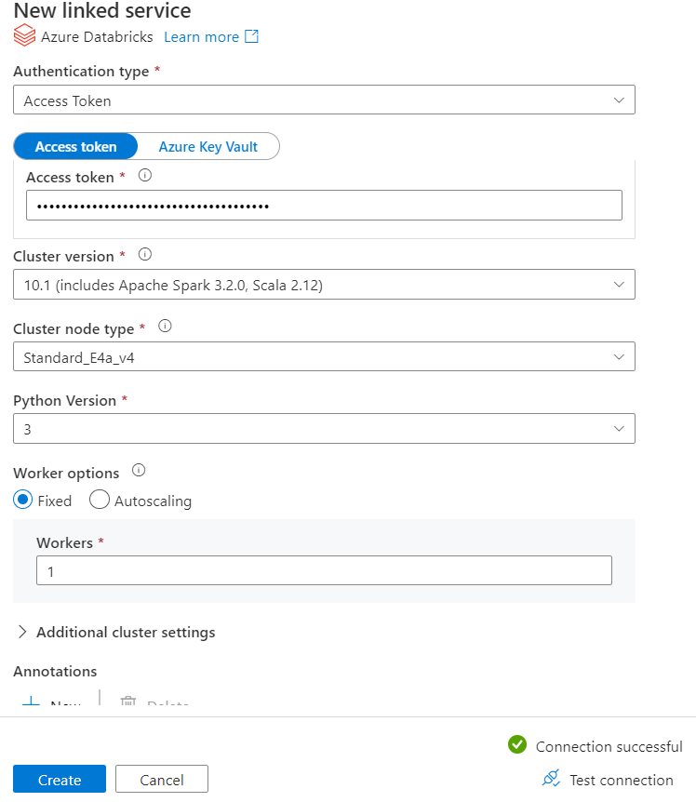

Create new linked service for databricks

Slide 31




Access token for Authentication
We need access token for Authentication type in new linked services.
Go to databricks workspace then Settings then user settings to acces token.
Click on generate token and copy the token and paste it in authentication type.

Slide 32


triggering
→ Choose notebook in pipeline and publish pipeline to trigger.

Slide 33



→ After publication click on New/Edit and fill details for new trigger and publish trigger.

Slide 34

Execution of trigger
Click on monitor to check execution of triggering.
We can see that linked notebook of data bricks from data factory is successfully triggered. We can see trigger runs also.

Slide 35

Results and conclusion
Result : linked and triggered azure Data Bricks Notebook using Azure Data Facotry.
Conclusion: Azure Data Factory linked with Azure Data Bricks.

